Slide 1

Data Structures (15B11CI311) Odd Semester 2021
3rd Semester , Computer Science and Engineering
Jaypee Institute Of Information Technology (JIIT), Noida

Slide 2
Sorting Techniques in Data Structure

Slide 3
Outlines:
Divide and Conquer
Merge Sort
Quick Sor
Radix Sort
Count Sort
Bucket Sort

Slide 4
Divide-and-Conquer
Divide and conquer is a strategy to solving a large problem by:
Divide the problem into a number of sub-problems
Similar sub-problems of smaller size
Conquer the sub-problems
Solve the sub-problems recursively
Sub-problem size small enough solve the problems in straight forward manner
Combine the solutions of the sub-problems
Obtain the solution for the original problem
4
Notes:
4

Slide 5
Merge Sort
Merge sort is a one of the efficient sorting algorithm.
Merge sort work on a principle of divide-and-conquer algorithm.
Merge sort repeatedly breaks down an array into several sub array until each sub array consists of a single element
Merge the sub-problem solutions together:
Compare the sub-array’s first elements
Remove the smallest element and put it into the result array
Continue the process until all elements have been put into the result array

Slide 6
Illustration of Merge Sort
98
23
45
14
6
67
33
42

Slide 7
98
23
45
14
6
67
33
42
98
23
45
14
6
67
33
42

Slide 8
98
23
45
14
6
67
33
42
98
23
45
14
6
67
33
42
98
23
45
14

Slide 9
98
23
45
14
6
67
33
42
98
23
45
14
6
67
33
42
98
23
45
14
98
23

Slide 10
98
23
45
14
6
67
33
42
98
23
45
14
6
67
33
42
98
23
45
14
98
23
Merge

Slide 11
98
23
45
14
6
67
33
42
98
23
45
14
6
67
33
42
98
23
45
14
98
23
23
Merge

Slide 12
98
23
45
14
6
67
33
42
98
23
45
14
6
67
33
42
98
23
45
14
98
23
23
98
Merge

Slide 13
98
23
45
14
6
67
33
42
98
23
45
14
6
67
33
42
98
23
45
14
98
23
45
14
23
98

Slide 14
98
23
45
14
6
67
33
42
98
23
45
14
6
67
33
42
98
23
45
14
98
23
45
14
23
98
Merge

Slide 15
98
23
45
14
6
67
33
42
98
23
45
14
6
67
33
42
98
23
45
14
98
23
45
14
23
98
14
Merge

Slide 16
98
23
45
14
6
67
33
42
98
23
45
14
6
67
33
42
98
23
45
14
98
23
45
14
23
98
14
45
Merge

Slide 17
98
23
45
14
6
67
33
42
98
23
45
14
6
67
33
42
98
23
45
14
98
23
45
14
23
98
14
45
Merge

Slide 18
98
23
45
14
6
67
33
42
98
23
45
14
6
67
33
42
98
23
45
14
98
23
45
14
23
98
14
45
14
Merge

Slide 19
98
23
45
14
6
67
33
42
98
23
45
14
6
67
33
42
98
23
45
14
98
23
45
14
23
98
14
45
14
23
Merge

Slide 20
98
23
45
14
6
67
33
42
98
23
45
14
6
67
33
42
98
23
45
14
98
23
45
14
23
98
14
45
14
23
45
Merge

Slide 21
98
23
45
14
6
67
33
42
98
23
45
14
6
67
33
42
98
23
45
14
98
23
45
14
23
98
14
45
14
23
45
98
Merge

Slide 22
98
23
45
14
6
67
33
42
98
23
45
14
6
67
33
42
98
23
45
14
6
67
33
42
98
23
45
14
23
98
14
45
14
23
45
98

Slide 23
98
23
45
14
6
67
33
42
98
23
45
14
6
67
33
42
98
23
45
14
6
67
33
42
98
23
45
14
6
67
23
98
14
45
14
23
45
98

Slide 24
98
23
45
14
6
67
33
42
98
23
45
14
6
67
33
42
98
23
45
14
6
67
33
42
98
23
45
14
6
67
23
98
14
45
14
23
45
98
Merge

Slide 25
98
23
45
14
6
67
33
42
98
23
45
14
6
67
33
42
98
23
45
14
6
67
33
42
98
23
45
14
6
67
23
98
14
45
6
14
23
45
98
Merge

Slide 26
98
23
45
14
6
67
33
42
98
23
45
14
6
67
33
42
98
23
45
14
6
67
33
42
98
23
45
14
6
67
23
98
14
45
6
67
14
23
45
98
Merge

Slide 27
98
23
45
14
6
67
33
42
98
23
45
14
6
67
33
42
98
23
45
14
6
67
33
42
98
23
45
14
6
67
33
42
23
98
14
45
6
67
14
23
45
98

Slide 28
98
23
45
14
6
67
33
42
98
23
45
14
6
67
33
42
98
23
45
14
6
67
33
42
98
23
45
14
6
67
33
42
23
98
14
45
6
67
14
23
45
98
Merge

Slide 29
98
23
45
14
6
67
33
42
98
23
45
14
6
67
33
42
98
23
45
14
6
67
33
42
98
23
45
14
6
67
33
42
23
98
14
45
6
67
33
14
23
45
98
Merge

Slide 30
98
23
45
14
6
67
33
42
98
23
45
14
6
67
33
42
98
23
45
14
6
67
33
42
98
23
45
14
6
67
33
42
23
98
14
45
6
67
33
42
14
23
45
98
Merge

Slide 31
98
23
45
14
6
67
33
42
98
23
45
14
6
67
33
42
98
23
45
14
6
67
33
42
98
23
45
14
6
67
33
42
23
98
14
45
6
67
33
42
14
23
45
98
Merge

Slide 32
98
23
45
14
6
67
33
42
98
23
45
14
6
67
33
42
98
23
45
14
6
67
33
42
98
23
45
14
6
67
33
42
23
98
14
45
6
67
33
42
14
23
45
98
6
Merge

Slide 33
98
23
45
14
6
67
33
42
98
23
45
14
6
67
33
42
98
23
45
14
6
67
33
42
98
23
45
14
6
67
33
42
23
98
14
45
6
67
33
42
14
23
45
98
6
33
Merge

Slide 34
98
23
45
14
6
67
33
42
98
23
45
14
6
67
33
42
98
23
45
14
6
67
33
42
98
23
45
14
6
67
33
42
23
98
14
45
6
67
33
42
14
23
45
98
6
33
42
Merge

Slide 35
98
23
45
14
6
67
33
42
98
23
45
14
6
67
33
42
98
23
45
14
6
67
33
42
98
23
45
14
6
67
33
42
23
98
14
45
6
67
33
42
14
23
45
98
6
33
42
67
Merge

Slide 36
98
23
45
14
6
67
33
42
98
23
45
14
6
67
33
42
98
23
45
14
6
67
33
42
98
23
45
14
6
67
33
42
23
98
14
45
6
67
33
42
14
23
45
98
6
33
42
67
Merge

Slide 37
98
23
45
14
6
67
33
42
98
23
45
14
6
67
33
42
98
23
45
14
6
67
33
42
98
23
45
14
6
67
33
42
23
98
14
45
6
67
33
42
14
23
45
98
6
33
42
67
6
Merge

Slide 38
98
23
45
14
6
67
33
42
98
23
45
14
6
67
33
42
98
23
45
14
6
67
33
42
98
23
45
14
6
67
33
42
23
98
14
45
6
67
33
42
14
23
45
98
6
33
42
67
6
14
Merge

Slide 39
98
23
45
14
6
67
33
42
98
23
45
14
6
67
33
42
98
23
45
14
6
67
33
42
98
23
45
14
6
67
33
42
23
98
14
45
6
67
33
42
14
23
45
98
6
33
42
67
6
14
23
Merge

Slide 40
98
23
45
14
6
67
33
42
98
23
45
14
6
67
33
42
98
23
45
14
6
67
33
42
98
23
45
14
6
67
33
42
23
98
14
45
6
67
33
42
14
23
45
98
6
33
42
67
6
14
23
33
Merge

Slide 41
98
23
45
14
6
67
33
42
98
23
45
14
6
67
33
42
98
23
45
14
6
67
33
42
98
23
45
14
6
67
33
42
23
98
14
45
6
67
33
42
14
23
45
98
6
33
42
67
6
14
23
33
42
Merge

Slide 42
98
23
45
14
6
67
33
42
98
23
45
14
6
67
33
42
98
23
45
14
6
67
33
42
98
23
45
14
6
67
33
42
23
98
14
45
6
67
33
42
14
23
45
98
6
33
42
67
6
14
23
33
42
45
Merge

Slide 43
98
23
45
14
6
67
33
42
98
23
45
14
6
67
33
42
98
23
45
14
6
67
33
42
98
23
45
14
6
67
33
42
23
98
14
45
6
67
33
42
14
23
45
98
6
33
42
67
6
14
23
33
42
45
67
Merge

Slide 44
98
23
45
14
6
67
33
42
98
23
45
14
6
67
33
42
98
23
45
14
6
67
33
42
98
23
45
14
6
67
33
42
23
98
14
45
6
67
33
42
14
23
45
98
6
33
42
67
6
14
23
33
42
45
67
98
Merge

Slide 45
98
23
45
14
6
67
33
42
98
23
45
14
6
67
33
42
98
23
45
14
6
67
33
42
98
23
45
14
6
67
33
42
23
98
14
45
6
67
33
42
14
23
45
98
6
33
42
67
6
14
23
33
42
45
67
98

Slide 46
98
23
45
14
6
67
33
42
Sorted Array
6
14
23
33
42
45
67
98

Slide 47
Merge Sort Algorithm
INPUT: a sequence of n numbers stored in array A
OUTPUT: an sorted sequence of n numbers
l points first element index of array and r points the index of last element
MergeSort (A, p, r) // sort A[p..r] by divide & conquer
if p< r
then q (p+r)/2
MergeSort (A, p, q)
MergeSort (A, q+1, r)
Merge (A, p, q, r) // merges A[p..q] with A[q+1..r]
Check for base case
Divide
Conquer
Conquer
Combine
Initial Call: MergeSort(A, 1, n)

Slide 48
Procedure Merge
Merge(A, p, q, r)
n₁ ← q – p + 1
n₂ ← r – q
for i ← 1 to n₁
do L[i] ← A[p + i – 1]
for j ← 1 to n₂
do R[j] ← A[q + j]
L[n₁+1] ← ∞
R[n₂+1] ← ∞
i ← 1
j ← 1
for k ←p to r
do if L[i] ≤ R[j]
then A[k] ← L[i]
i ← i + 1
else A[k] ← R[j]
j ← j + 1
Input: Array containing sorted subarrays A[p..q] and A[q+1..r].
Output: Merged sorted subarray in A[p..r].
O(n)
Sentinels, to avoid having to check if either subarray is fully copied at each step.
Source: Cormen, Thomas H.; Leiserson, Charles E.; Rivest, Ronald L.; Stein, Clifford (2009) [1990]. Introduction to Algorithms (3rd ed.). MIT Press and McGraw-Hill. ISBN 0-262-03384-4. 1320 pp

Slide 49
Merge-sort is out-place sorting technique. During merge procedure it takes O(n) extra space. Therefore merge sort is not in-place sorting algorithm.
Merge sort is not better approach for smaller size array.
For smaller size array use insertion sort only.
Merge sort is a stable sorting algorithm. After sorting if repeated element order not changes is called stable sorting technique.

Slide 50
Time Analysis of Merge Sort
MergeSort (A, p, r) // sort A[p..r] by divide & conquer
if p < r
then q ← ⎣(p+r)/2⎦
MergeSort (A, p, q)
MergeSort (A, q+1, r)
Merge (A, p, q, r) // merges A[p..q] with A[q+1..r] `
O(1)
T(n/2)
O(n)
T(n/2)
So, we can write the overall running time of MERGE-SORT function in the form of recurrence relation as:
T(n)=2T(n/2)+Θ(n)+Θ(1)
So Solving above equation: Θ(nlgn)

Slide 51
Quicksort Algorithm
Given an array of n elements (e.g., integers):
If array contains only one element, return
Else
pick one element to use as pivot.
Partition elements into two sub-arrays:
Left sub-array contains elements less than or equal to pivot
Right sub-array contains elements greater than pivot
Then repeatedly apply above two steps on the two sub-arrays until array become sorted
Return results

Slide 52
Partitioning Array
Given a pivot, partition the elements of the array such that the resulting array ,consists of:
One sub-array that contains elements > pivot
Another sub-array that contains elements <= pivot
The sub-arrays are stored in the original data array.
Partitioning loops through, swapping elements below/above pivot.

Slide 53
Partition – Choosing the pivot
First, we have to select a pivot element among the elements of the given array.
Which array item should be selected as pivot?
Somehow we have to select a pivot, and we hope that we will get a good partitioning.
If the items in the array arranged randomly, we choose a pivot randomly.
We can choose the first or last element as a pivot (it may not give a good partitioning).
We can use different techniques to select the pivot.

Slide 54
Quick Sort Algorithm
As the name implies, it is quick, and it is the algorithm generally preferred for sorting.
Basic Ideas
(Another divide-and-conquer algorithm)
Pick an element, say P(the pivot)
Re-arrange the elements into 3 sub-blocks,
1.those less than or equal to (≤) P(the left-block S1)
2. P(the only element in the middle-block)
3. those greater than or equal to (≥) P(the right-block S2)
Repeat the process recursively for the left-and right-sub-blocks. Return {quicksort(S1), P, quicksort(S2)}.(That is the results of quicksort(S1), followed by P, followed by the results of quicksort(S2))

Slide 55

Basic Ideas
S is a set of numbers
S₁ = {x ∈ S – {P} | x ≤ P}
P
S₂ = { x∈ S – {P} | P ≤ x}
Source:https://home.cse.ust.hk/~dekai/271/notes/L01a/quickSort.pdf
Quick Sort
55

Slide 56


Basic Ideas
Pick a “Pivot” value, P Create 2 new sets without P
Items smaller than or equal to P
Items greater than or equal to P
0 31
13 43
26 57
≤
≤
75
92 81
quciksort(S₂)
65
quicksort(S₁)
0 13 26 31 43 57
≤
65
≤
75 81 92
0 13 26 31 43 57 65 75 81 92
Source:https://home.cse.ust.hk/~dekai/271/notes/L01a/quickSort.pdf
56

Slide 57
Quicksort Code:
void quicksort(int a[], int p, int r)
{
if(p < r)
{ int q;
q = partition(a, p, r);
quicksort(a, p, q-1);
quicksort(a, q+1, r);
}
}
int partition (int arr[], int low, int high)
{
O(n)
T(i)
T(n-i-1)
Source: Cormen, Thomas H.; Leiserson, Charles E.; Rivest, Ronald L.; Stein, Clifford (2009) [1990]. Introduction to Algorithms (3rd ed.). MIT Press and McGraw-Hill. ISBN 0-262-03384-4. 1320 pp

Slide 58
int pivot = arr[high]; // selecting last element as pivot
int i = (low - 1); // index of smaller element
for (int j = low; j <= high- 1; j++)
{
// If the current element is smaller than or equal to pivot
if (arr[j] <= pivot)
{ i++; // increment index of smaller element
swap(&arr[i], &arr[j]);
}
}
swap(&arr[i + 1], &arr[high]);
Return (i + 1);
}
Source: Cormen, Thomas H.; Leiserson, Charles E.; Rivest, Ronald L.; Stein, Clifford (2009) [1990]. Introduction to Algorithms (3rd ed.). MIT Press and McGraw-Hill. ISBN 0-262-03384-4. 1320 pp

Slide 59
Lightly shaded array elements are all in the first partition with values no greater than x. Heavily shaded elements are in the second partition with values greater than x. The unshaded elements have not yet been put in one of the first two partitions, and the final white element is the pivot x
i
p j
r
The initial array and variable settings. None of the elements have been placed in either of the first two partitions.
2 | 8 | 7 | 1 | 3 | 5 | 6 | 4
i p
j
r
2 | 8 | 7 | 1 | 3 | 5 | 6 | 4
The value 2 is “swapped with itself” and put in the partition of smaller values
i p
j
r
2 | 8 | 7 | 1 | 3 | 5 | 6 | 4
The values 8 and 7 are added to the partition of larger values
i p
j
r
2 | 8 | 7 | 1 | 3 | 5 | 6 | 4
p
i
j
r
2 | 1 | 7 | 8 | 3 | 5 | 6 | 4
The values 1 and 8 are swapped, and the smaller partition grows.

Slide 60
p
i
j
r
The values 3 and 7 are swapped, and the smaller partition grows.
2 | 1 | 3 | 8 | 7 | 5 | 6 | 4
p
i
j
r
2 | 1 | 3 | 8 | 7 | 5 | 6 | 4
The larger partition grows to include 5 and 6, and the loop terminates.
p
i
r
2 | 1 | 3 | 8 | 7 | 5 | 6 | 4
p
i
r
In lines 7–8, the pivot element is swapped so that it lies between the two partitions.
2 | 1 | 3 | 4 | 7 | 5 | 6 | 8

Slide 61
Running time analysis
The advantage of this quicksort is that we can sort “in-place”, i.e., without the need for a temporary buffer depending on the size of the inputs.
Partitioning Step: Time Complexity is O(n).
Recall that quicksort involves partitioning, and 2 recursive calls.
Thus, giving the basic quicksort relation:
T(n) = O(n) + T(i) + T(n-i-1) = cn+ T(i) + T(n-i-1)
where i is the size of the first sub-block after partitioning.
We shall take T(0) = T(1) = 1 as the initial conditions.
To find the solution for this relation, we’ll consider three cases:
The Worst-case
The Best-case
The Average-case
All above cases depends on the value of the pivot!!

Slide 62
Running time analysis
Worst-Case (Data is sorted already)
When the pivot is the smallest (or largest) element at partitioning on a block of size n, the result
yields one empty sub-block, one element (pivot) in the “correct” place and one sub-block of size (n-1)
takes O(n) times.
Recurrence Equation:
T(1) = 1
T(n) = T(n-1) + cn
Solution: O(n² )
Worse than Mergesort!!!

Slide 63
Running time analysis
Best case:
The pivot is in the middle (median) (at each partition step), i.e. after each partitioning, on a block of size n, the result
yields two sub-blocks of approximately equal size and the pivot element in the “middle” position
takes n data comparisons.
Recurrence Equation becomes
T(1) = 1
T(n) = 2T(n/2) + cn
Solution: O(n logn)
Comparable to Mergesort!!

Slide 64
Running time analysis
Average case:
The average case input would be any randomly generated arrays and the pivot is at the random position every step.
It turns out the average case running time also is O(n logn).
More in detail will discuss offline.

Slide 65
So the trick is to select a good pivot
Different ways to select a good pivot.
First element
Last element
Median-of-three elements
Pick three elements, and find the median x of these elements. Use that median as the pivot.
Random element
Randomly pick a element as a pivot.

Slide 66
Selection problem : a ‘faster’ answer.
We can borrow the idea from the partition algorithm. Suppose we want to find a element of rank i in A[1..n]. After the 1st partition call (use a random element as pivot):
If the return index ‘q’ = i, then A[q] is the element we want. (Since there is exactly i-1 elements smaller than or equal to A[q]).
If the return index ‘q’ > i, then the target element can NOT be in A[q .. right].The target element is rank i in A[1.. q-1] Recursive call with parameters (A, 1, q-1, i).
If the return index ‘q’ < i, then the target element can NOT be in A[1 .. q]. The target element is rank i-q in A[q+1 ..n] Recursive call with parameters (A, q+1,n, i-q).

Slide 67
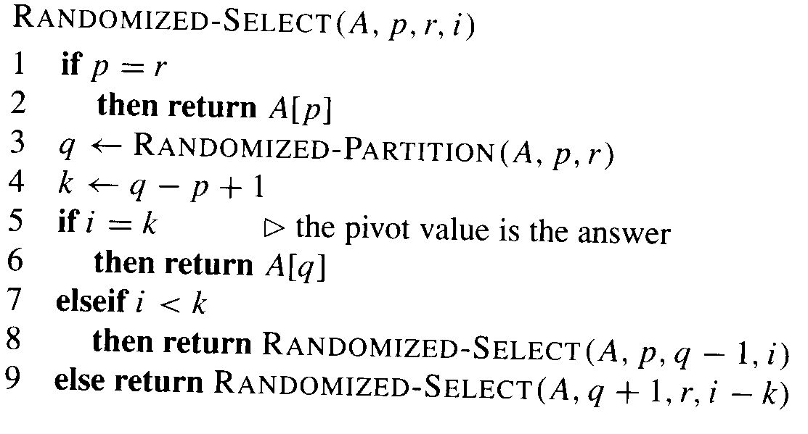
A ‘faster’ selection algorithm : Codes
return a element of rank i in A[p..r]
A[p..q-1] ≤ A[q] ≤ A[q+1..r]
size of A[p..q]= k
Source: Cormen, Thomas H.; Leiserson, Charles E.; Rivest, Ronald L.; Stein, Clifford (2009) [1990]. Introduction to Algorithms (3rd ed.). MIT Press and McGraw-Hill. ISBN 0-262-03384-4. 1320 pp

Slide 68
Different sorting algorithms
Sorting Algorithm | Worst-case time | Average- case time | Space overhead
Bubble Sort | Θ (n²) | Θ (n²) | Θ(1)
Insertion Sort | Θ (n²) | Θ (n²) | Θ(1)
Merge Sort | Θ (n log n) | Θ (n log n) | Θ(n)
Quick Sort | Θ (n²) | Θ (n log n) | Θ(1)

Slide 69
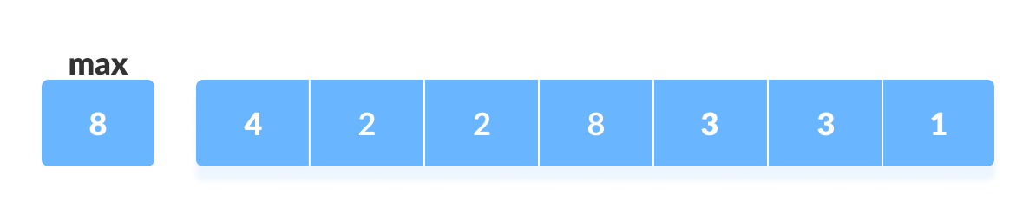
Counting Sort
.
Counting sort is a sorting algorithm that sorts the elements of an array by counting the number of occurrences of each unique element in the array.
The count is stored in an auxiliary array and the sorting is done by mapping the count as an index of the auxiliary array.
How Counting Sort Works?
Find out the maximum element (let it be max) from the given array:

Slide 70
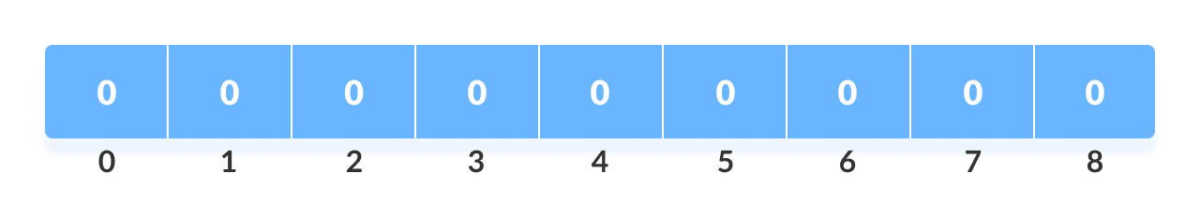
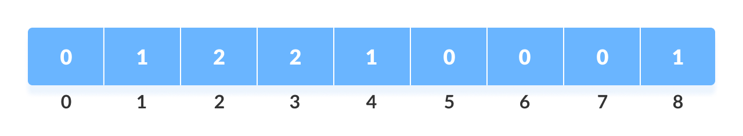
2. Initialize an array of length max+1 with all elements 0. This array is used for storing the count of the elements in the array.
3. Store the count of each element at their respective index in count array. For example: if the count of element 3 is 2 then, 2 is stored in the 3rd position of count array. If element "5" is not present in the array, then 0 is stored in 5th position.
3.
https://www.programiz.com/dsa/counting-sort

Slide 71
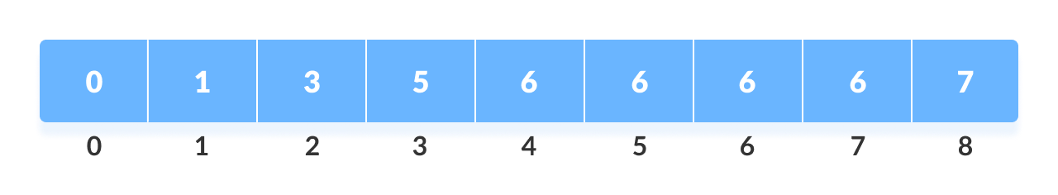
4. Store cumulative sum of the elements of the count array. It helps in placing the elements into the correct index of the sorted array.
5. Find the index of each element of the original array in the count array. This gives the cumulative count. Place the element at the index calculated as shown in figure below
https://www.programiz.com/dsa/counting-sort

Slide 72
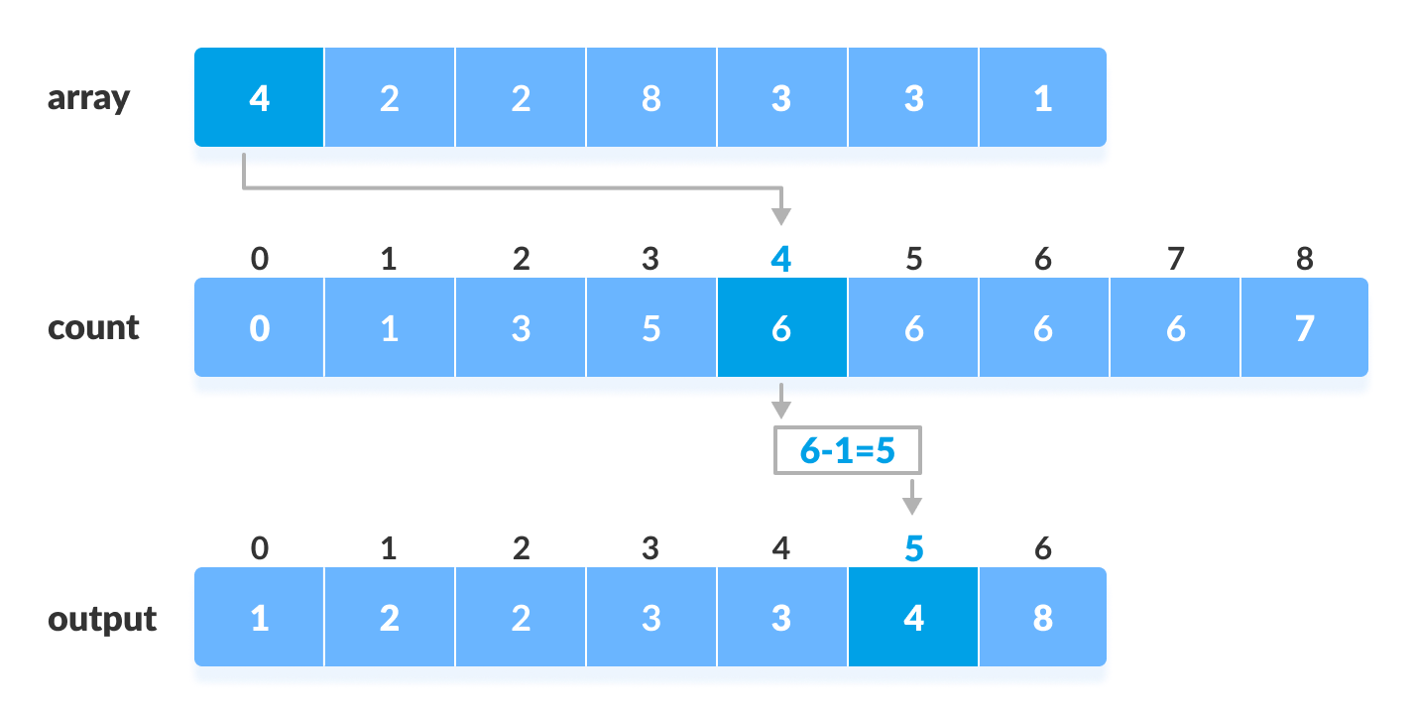
6. After placing each element at its correct position, decrease its count by one.
https://www.programiz.com/dsa/counting-sort

Slide 73
Counting Sort Algorithm
countingSort(array, size)
max <- find largest element in array
initialize count array with all zeros
for j <- 0 to size
find the total count of each unique element and
store the count at jth index in count array
for i <- 1 to max
find the cumulative sum and store it in count array itself
for j <- size down to 1
restore the elements to array decrease count of each element restored by 1

Slide 74
Radix Sort
This sort is unusual because it does not directly compare any of the elements
We instead create a set of buckets and repeatedly separate the elements into the buckets
On each pass, we look at a different part of the elements.
Assuming decimal elements and 10 buckets, we would put the elements into the bucket associated with its units digit
The buckets are actually queues so the elements are added at the end of the bucket
At the end of the pass, the buckets are combined in increasing
74

Slide 75
Radix Sort
On the second pass, we separate the elements based on the “tens” digit, and on the third pass we separate them based on the “hundreds” digit
Each pass must make sure to process the elements in order and to put the buckets back together in the correct order.
Radix sort use counting sort in the intermediate steps.
75

Slide 76
Working of Radix Sort:
Find the largest element in the array, i.e. max. Let X be the number of digits n max. X is calculated because we have to go through all the significant places of all elements.
In the below array, we have the largest number 799. It has 3 digits. Therefore, the loop should go up to hundreds place (3 times).
2. Now, go through each significant place one by one. Use any stable sorting technique(Counting Sort) to sort the digits at each significant place. We have used counting sort for this
.
124 | 436 | 562 | 22 | 1 | 26 | 799

Slide 77
3. Sort the elements based on the unit place digits (X=0).
Array
4 | 6 | 2 | 2 | 1 | 6 | 9
0 | 1 | 2 | 3 | 4 | 5 | 6 | 7 | 8 | 9
0 | 1 | 2 | 0 | 1 | 0 | 2 | 0 | 0 | 1
Count
Array
4 | 6 | 2 | 2 | 1 | 6 | 9
0 | 1 | 2 | 3 | 4 | 5 | 6 | 7 | 8 | 9
0 | 1 | 3 | 3 | 4 | 4 | 6 | 6 | 6 | 7
Cumulative Count
4-1=3
6-1=5
Output
1 | 2 | 2 | 4 | 6 | 6 | 9
Original array sorted at unit place
1 | 562 | 22 | 124 | 436 | 26 | 799

Slide 78
3. Now, sort the elements based on digits at tens place.
4. Finally, sort the elements based on the digits at hundreds place
1 | 22 | 124 | 26 | 436 | 562 | 799
Sort elements based on tens place
001 | 022 | 026 | 124 | 436 | 562 | 799
Sort elements based on hundreds place

Slide 79
void radixsort(int array[], int size)
{ // Get maximum element
int max = getMax(array, size);
// Apply counting sort to sort elements based on place value.
for (int place = 1; max / place > 0; place *= 10)
countingSort(array, size, place);
}
void countingSort(int array[], int size, int place)
{
const int max = 10;
int output[size]; int count[max];
for (int i = 0; i < max; ++i)

Slide 80
count[i] = 0; // Calculate count of elements
for (int i = 0; i < size; i++)
count[(array[i] / place) % 10]++;
for (int i = 1; i < max; i++)
count[i] += count[i - 1];
for (int i = size - 1; i >= 0; i--)
{ output[count[(array[i] / place) % 10] - 1] = array[i];
count[(array[i] / place) % 10]--;
}
for (int i = 0; i < size; i++)
array[i] = output[i]; }

Slide 81
Radix Sort Analysis
Each element is examined once for each of the digits it contains, so if the elements have at most M digits and there are N elements this algorithm has order O(M*N)
This means that sorting is linear based on the number of elements
Why then isn’t this the only sorting algorithm used?
81

Slide 82
Radix Sort Analysis
Though this is a very time efficient algorithm it is not space efficient
If an array is used for the buckets and we have B buckets, we would need N*B extra memory locations because it’s possible for all of the elements to wind up in one bucket
If linked lists are used for the buckets you have the overhead of pointers
82

Slide 83
Bucket Sort
Bucket sort is mainly useful when input is uniformly distributed over a range. For example, consider the following problem. Sort a large set of floating point numbers which are in range from 0.0 to 1.0 and are uniformly distributed across the range. How do we sort the numbers efficiently?
A simple way is to apply a comparison based sorting algorithm. The lower bound for comparison based sorting algorithm (Merge Sort, Heap Sort, Quick-Sort .. etc) is Ω(n Log n), i.e., they cannot do better than nlogn.
Can we sort the array in linear time? Counting sort can not be applied here as we use keys as index in counting sort. Here keys are floating point numbers.
The idea is to use bucket sort. Following is bucket algorithm.

Slide 84
Bucket_Sort(arr[], n)
1)Create n empty buckets (Or lists).
2) Do following for every array element arr[i].
a) Insert arr[i] into bucket[n*array[i]]
3) Sort individual buckets using insertion sort.
4) Concatenate all sorted buckets.

Slide 85
Bucket Sort Example
0 | 0.78
1 | 0.17
2 | 0.39
3 | 0.26
4 | 0.72
5 | 0.94
6 | 0.21
7 | 0.12
8 | 0.23
9 | 0.68
0
1
2
3
4
5
6
7
8
9
0.12
0.17
0.21
0.23
0.26
0.39
0.68
0.72
0.78
0.94
Input Array
Bucket Sort

Slide 86
Complexity of Bucket Sort
Worst Case Complexity: O(n²)
When there are elements of close range in the array, they are likely to be placed in the same bucket. This may result in some buckets having more number of elements than others.
Best Case Complexity: O(n+k) It occurs when the elements are uniformly distributed in the buckets with a nearly equal number of elements in each bucket.
Average Case Complexity: O(n) It occurs when the elements are distributed randomly in the array. Even if the elements are not distributed uniformly, bucket sort runs in linear time

Slide 87
References:
Cormen, Thomas H.; Leiserson, Charles E.; Rivest, Ronald L.; Stein, Clifford (2009) [1990]. Introduction to Algorithms (3rd ed.). MIT Press and McGraw-Hill. ISBN 0-262-03384-4. 1320 pp.
https://home.cse.ust.hk/~dekai/271/notes/L01a/quickSort.pdf
https://www.programiz.com/dsa/counting-sort

